Slide 1


Go around the world without hassles...

Slide 2

Our Aim :
At BHROMON, our aim is to be a premier tourism company in India that embodies the true spirit of this incredible and diverse nation. India is not just a destination; it is an experience, a journey that unveils its rich history, cultural heritage, natural wonders, and the warmth of its people. Our commitment is to promote India as a world-class travel destination, while ensuring that our operations are rooted in sustainable practices, inclusivity, and the highest standards of quality and authenticity.
This Photo by Unknown author is licensed under CC BY-NC-ND.

Slide 3

Here are some key features that we offer…
1.Customized Itineraries:
Tailor-made travel packages to suit individual preferences and interests.
Options for different travel styles, such as adventure, cultural, historical, religious, or leisure tourism.
2.Professional Guides and Local Experts:
Experienced tour guides and local experts who provide insights into India's history, culture, and traditions.
Multilingual guides for travelers from different parts of the world.
3.Transportation Services:
Well-maintained, comfortable, and safe transportation options for different group sizes, including cars, buses, and domestic flights.
Assistance with airport transfers and inter-city travel.

Slide 4

4.Safety and Support:
24/7 customer support and assistance during travel.
Comprehensive safety measures and emergency response plans.
5.Group and Solo Travel Options:
Packages tailored for solo travelers, families, friends, and larger groups.
Group discounts and special arrangements for group travel.
6.Local Art and Handicrafts:
Recommendations for shopping local handicrafts, textiles, and souvenirs.
Assistance with finding authentic and ethically-sourced products.
7.Cultural Sensitivity:
Emphasis on respecting local customs, traditions, and etiquette.
Promoting responsible tourism that benefits local communities.
8.Feedback and Reviews:
Platforms for customers to leave reviews and feedback.
Continuous improvement based on customer suggestions and experiences.
This Photo by Unknown author is licensed under CC BY-NC-ND.

Slide 5
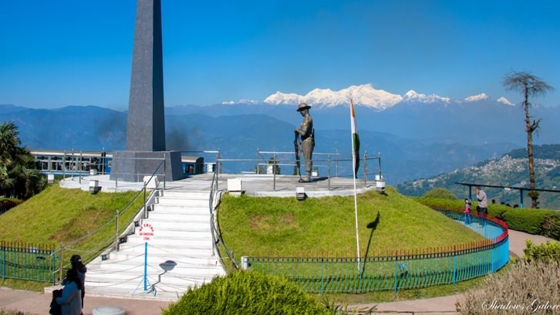
THANK YOU
This Photo by Unknown author is licensed under CC BY-NC.

